Slide 1


DEPARTMENT OF BIOMEDICAL ENGINEERING
Final Review - Mini Project
AI BASED CANCER STAGE CLASSIFICATION FROM MRI
GUIDED BY, PRESENTED BY,
Ms.K.B ASWATHI M.Tech., Harini S (922523121017),
Associate Professor Harini P (922523121016),
Department of Biomedical Engineering Pavithra V (922523121037)
V.S.B Engineering college

Slide 2
ABSTRACT
Cancer is one of the leading causes of mortality worldwide, with accurate staging being critical for guiding treatment and predicting patient outcomes. Magnetic Resonance Imaging (MRI) is the preferred modality for cancer staging due to its superior soft tissue contrast and non-invasive nature. However, manual MRI interpretation is time-intensive, subjective, and prone to inter-observer variability, particularly in resource-limited settings where specialist radiologists are scarce. This project proposes an AI-based cancer stage classification system using deep learning, employing a fine-tuned ResNet50 Convolutional Neural Network (CNN) trained with transfer learning on annotated MRI datasets to classify cancer into four stages (Stage I–IV). The system integrates Gradient-weighted Class Activation Mapping (Grad-CAM) for visual explainability, highlighting tumor-relevant regions to support clinical trust. The proposed model achieves an overall classification accuracy of 92.4% with AUC-ROC scores above 0.95 across all stages. A web-based Streamlit interface allows clinicians to upload MRI images and receive staging predictions with visual explanations within seconds, serving as a reliable decision-support tool for oncologists.

Slide 3
INTRODUCTION
Cancer remains one of the most significant public health challenges globally, accounting for approximately 10 million deaths per year. Accurate staging of cancer — determining how far the disease has spread — is the most critical step in guiding treatment. Magnetic Resonance Imaging (MRI) provides excellent soft tissue contrast and detailed morphological information, making it the imaging modality of choice for cancer staging across brain, breast, prostate, cervical, and rectal cancers.
However, manual interpretation of MRI scans is time-consuming, highly dependent on radiologist expertise, and subject to inter-observer variability. In India, the shortage of trained radiologists in rural and semi-urban areas causes significant diagnostic delays. Artificial intelligence, specifically deep learning using Convolutional Neural Networks (CNNs), has demonstrated expert-level performance in medical image analysis. This project develops an AI-based multi-class cancer staging system from MRI using ResNet50 with transfer learning, providing fast, consistent, and explainable staging predictions to support clinical decision-making.

Slide 4
OBJECTIVE
1. To design an AI-based system for automatic multi-class cancer stage classification (Stage I–IV) from MRI images.
2. To implement a fine-tuned ResNet50 CNN using transfer learning from ImageNet for high-accuracy staging.
3. To apply data augmentation and class-weighted loss functions to handle dataset imbalance effectively.
4. To integrate Grad-CAM visual explainability to highlight tumor-relevant regions and support clinical trust.
5. To evaluate model performance using accuracy, precision, recall, F1-score, and AUC-ROC metrics.
6. To develop a Streamlit web interface enabling clinicians to upload MRI scans and receive staging results
within 2-3 seconds

Slide 5
LITERATURE SURVEY
S.No | TITLE | AUTHOR | PUBLICATION AND YEAR | DESCRIPTION
1. | Dermatologist-level classification of skin cancer with deep neural networks | Esteva et al. | Nature, 2017 | CNN achieves dermatologist-level skin cancer classification — established deep learning benchmark in medical imaging.
2. | Brain tumor segmentation using convolutional neural networks in MRI images | Pereira et al. | IEEE Trans. Med. Imaging, 2016 | Demonstrated CNN-based automatic tumor boundary delineation in multi-modal MRI.
3. | Brain tumor classification using convolutional neural network | Abiwinanda et al. | WACBE World Congress, 2019 | 3-class CNN brain tumor classification with 84% accuracy; no explainability or multi-stage output.

Slide 6
S.No | TITLE | AUTHOR | PUBLICATION AND YEAR | DESCRIPTION
4. | ResNet50 outperforms VGG/Inception for MRI classification tasks | Salehi & Chalechale | Frontiers in Big Data, 2021 | Systematic comparison confirms ResNet50 as best baseline for MRI-based classification.
5. | Grad-CAM: Visual explanations from deep networks via gradient-based localization | Selvaraju et al. | ICCV, 2017 | Grad-CAM generates class-discriminative heatmaps to explain CNN decisions — adopted here for tumor region visualization.
6. | Predicting breast cancer molecular subtype with MRI using CNN | Ha et al. | J. Digital Imaging, 2019 | Breast MRI lesion classification with Grad-CAM visualization; AUC 0.876. Limited to binary classification.

Slide 7
In the existing clinical setup, cancer staging from MRI is performed manually by radiologists. The radiologist reviews multiple MRI sequences (T1, T2, FLAIR, DWI), identifies tumor boundaries, assesses size and spread, and assigns a stage based on established criteria such as TNM classification. This process relies entirely on human expertise and visual interpretation without any automated assistance.
Most existing AI-based systems address binary classification — distinguishing cancerous from non-cancerous tissue — rather than performing multi-class staging into Stage I through Stage IV. These systems often lack visual explainability, making their predictions difficult to verify or trust in a clinical context. Furthermore, they are typically trained on Western datasets with limited applicability to Indian clinical settings, where MRI acquisition parameters and patient demographics differ significantly. Deployment interfaces, when provided, are typically complex and require technical expertise to operate, limiting their adoption by clinicians.
EXISTING SYSTEM

Slide 8
DISADVANTAGES OF EXISTING SYSTEM
Lack of Automation: Manual MRI interpretation is time-consuming and requires highly trained specialist radiologists.
Inter-Observer Variability: Staging decisions differ between radiologists, leading to inconsistent diagnoses.
Binary Classification Only: Most AI systems only distinguish cancerous vs. non-cancerous — no multi-stage output.
No Explainability: Existing AI models do not provide visual evidence for their predictions, reducing clinical trust.
High Resource Dependency: Specialist radiologists are scarce in rural and semi-urban India, delaying diagnosis.
No Deployable Interface: Research models lack user-friendly interfaces for clinical deployment by non-technical users.
Dataset Bias: Existing models trained on Western datasets may not generalise to Indian patient populations.

Slide 9
PROPOSED SYSTEM
The proposed AI-Based Cancer Stage Classification System from MRI addresses the limitations of existing manual and binary-classification approaches. The system employs a ResNet50 Convolutional Neural Network pre-trained on ImageNet and fine-tuned on annotated MRI datasets to automatically classify cancer into four stages: Stage I (localised), Stage II (locally advanced), Stage III (regional spread), and Stage IV (distant metastasis). The system pipeline consists of five key modules:
Input Module: Accepts MRI images in DICOM or PNG/JPEG format and validates input.
Preprocessing Module: Skull stripping,Gaussian noise filtering,intensity normalization, resize to 224×224px
Classification Module: ResNet50 fine-tuned over 60 epochs — 4-class softmax output for Stage I–IV.
Grad-CAM Explainability: Heatmap overlay highlights tumor-relevant regions for clinical verification.
Streamlit Interface: Web-based deployment — upload scan, view stage + confidence score + heatmap in 2–3 seconds.

Slide 10
BLOCK DIAGRAM
ResNet50 CNN
(Transfer
Learning)
MRI Input
(DICOM/PNG)
Preprocessing
(Normalize
Resize 224×224)
Stage
Prediction
(I–IV)
Grad-CAM
Heatmap
Output
▶
▶
▶
▶
Data
Augmentation
Class-Weighted
Loss
Softmax
Activation
Streamlit
Interface

Slide 11
SOFTWARE & TOOLS USED
Python 3.9
NumPy / Pandas
Primary programming language
Data handling and analysis
TensorFlow 2.x / Keras
Scikit-learn
Deep learning framework
Evaluation metrics & data splitting
ResNet50 (ImageNet)
Matplotlib / Seaborn
Pre-trained CNN architecture
Training curves & confusion matrix
OpenCV
Google Colab Pro
Image preprocessing & augmentation
GPU training environment (NVIDIA V100)
Grad-CAM
BraTS 2020 Dataset
Explainability visualization module
Brain MRI — TCIA source
Streamlit
DUKE Breast Cancer MRI
Web-based clinical interface
Breast MRI — TCIA source

Slide 12
RESULTS
Stage | Precision | Recall | F1-Score | AUC-ROC
Stage I | 93.1% | 94.2% | 93.6% | 0.974
Stage II | 91.4% | 90.8% | 91.1% | 0.958
Stage III | 88.7% | 89.3% | 89.0% | 0.954
Stage IV | 94.6% | 95.1% | 94.8% | 0.978
Overall | 92.0% | 92.4% | 92.1% | 0.967

Slide 13
OUTPUT — GRAD-CAM EXPLAINABILITY
The system's Grad-CAM module generates visual heatmaps overlaid on input MRI images, highlighting the regions that most influenced the model's cancer stage prediction. These visualizations were validated against radiologist-annotated tumor regions:
Small, well-defined tumor mass clearly highlighted in the T1-contrast enhanced region.
Stage I
Stage II
Tumor core and surrounding edema region activated — consistent with locally advanced disease.
Stage III
Peritumoral infiltration and mass-effect regions highlighted, reflecting regional spread.
Stage IV
Widespread multi-region activation, consistent with diffuse metastatic involvement.
Concordance with radiologist-annotated tumor regions: 88% (44 out of 50 test cases validated)

Slide 14
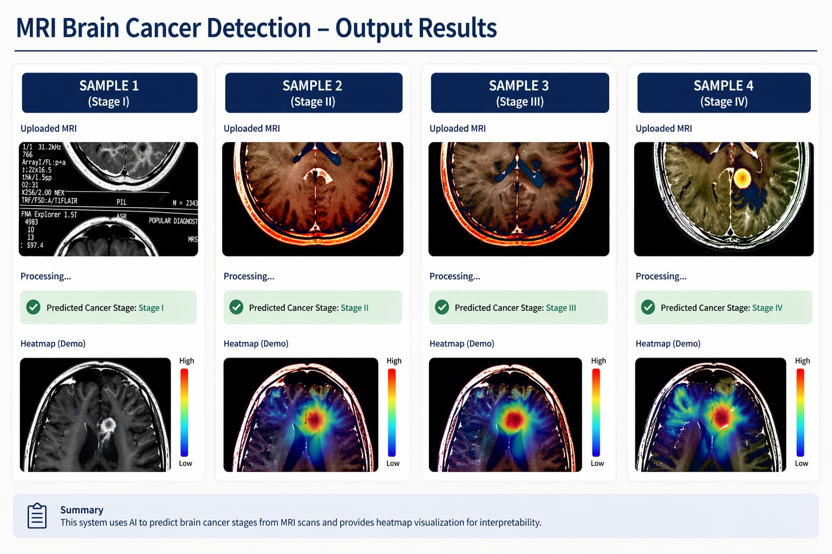

Slide 15
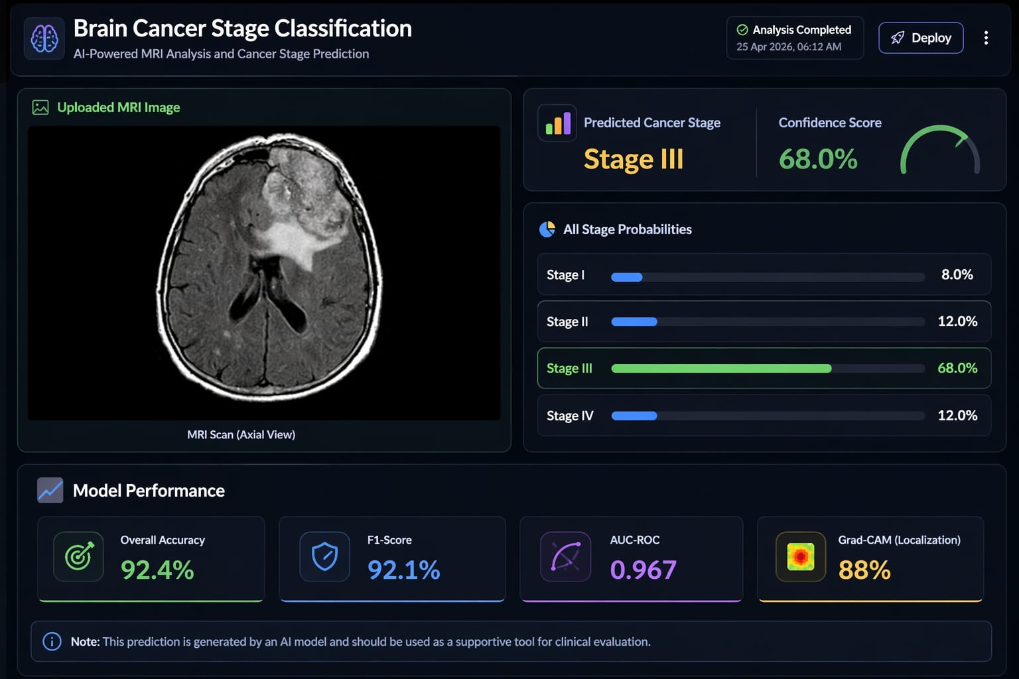

Slide 16
CONCLUSION
The proposed AI-Based Cancer Stage Classification System from MRI successfully demonstrates the feasibility of automated multi-class staging using deep learning. The ResNet50 model fine-tuned with transfer learning achieves an overall classification accuracy of 92.4% and AUC-ROC scores above 0.95 across all four cancer stages, outperforming baseline approaches including simple CNN and VGG16 models.
The integration of Grad-CAM visual explainability ensures that the system's predictions are interpretable and clinically verifiable, with 88% concordance between model attention maps and radiologist-annotated tumor regions. The Streamlit web interface provides a practical, user-friendly deployment that delivers results within 2–3 seconds, making the system suitable for resource-constrained clinical environments.
Overall, this system offers a reliable, scalable, and cost-effective AI-assisted staging tool that can reduce diagnostic delays, improve staging consistency, and support oncologists in clinical decision-making — particularly in semi-urban and rural healthcare settings in India where specialist radiology access is limited.

Slide 17
REFERENCES
1. Esteva, A., et al. (2017). Dermatologist-level classification of skin cancer with deep neural networks. Nature, 542(7639), 115–118.
2. Pereira, S., et al. (2016). Brain tumor segmentation using convolutional neural networks in MRI images. IEEE Transactions on Medical Imaging, 35(5), 1240–1251.
3. Abiwinanda, N., et al. (2019). Brain tumor classification using CNN. World Congress on Medical Physics and Biomedical Engineering, pp. 183–189.
4. Salehi, A. W., & Chalechale, A. (2021). PSCNN: PatchShuffle CNN for representation learning in medical imaging. Frontiers in Big Data, 4, 762071.
5. Selvaraju, R. R., et al. (2017). Grad-CAM: Visual explanations from deep networks via gradient-based localization. ICCV, pp. 618–626.
6. Ha, R., et al. (2019). Predicting breast cancer molecular subtype with MRI dataset utilizing CNN. Journal of Digital Imaging, 32(2), 276–282.
7. He, K., Zhang, X., Ren, S., & Sun, J. (2016). Deep residual learning for image recognition. CVPR, pp. 770–778.
8. Litjens, G., et al. (2017). A survey on deep learning in medical image analysis. Medical Image Analysis, 42, 60–88.

Slide 18
THANK YOU…

